Slide 1
5CS024 – 7CC002 Meetings and Tools

Slide 2

Technology Roadmaps
Captures the team’s vision for the project
Helps identify features and releases
Helps communicate intent
Helps identify roles and priorities in the team
Initiates fundamental questions and decisions
Innovation Funnel forms the starting point

Slide 3


Building an Innovation Funnel
Highest level model
Based on the original pitch
Involves the whole team
Starts with a group brain storm

Slide 4

Building an Innovation Funnel
Identify system stakeholders
Refine to identify the system’s direct users
Identify Usecases (Process, Services, Capabilities)
Set aside implementation details
Consider the user stories
Why do they interact with the system?
How do they interact with the system?
What Vision

Slide 5
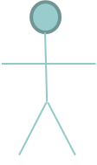


Context Diagram
Our System
Users/Actors
Usecase

Slide 6
Context Diagram
Stakeholders
Assign names
Think about roles and interaction
Users

Slide 7
Context Diagram
What will the system do? Who will it do them for?
Identify Usecases for the system
Users/Actors
Processes, Services, Capabilities
Assign appropriate names
Think high level and merge

Slide 8
Context Diagram
SkyLaundry
Collection
Customer
Register
Process payments
Bank
Dispatch
Driver

Slide 9
Innovation Funnel
Ideas
Features and ideas for work based on previous modelling
Validation
Filter and prioritise ideas, decide which features to make
Create
Features currently being coded and tested
Deliver
Working features (Cumulative)
Idea
Validation
Create
Deliver

Slide 10
Minimum Viable Product (MVP) Forecast
Goal
Minimum Viable Product- Simplest set of working functionality
Forecast tracks releases towards the goal
All releases are viable
Re-scope if appropriate
R4
R3
R2
R1
MVP

Slide 11
Collaborative editors
Code editors that let you collaborate with other programmers, help you to edit your code in real time and keep you constantly updated with changes in projects that you may otherwise overlook (source).
Serve a very specific need (quick share)
Not always suitable for day-to-day coding.

Slide 12
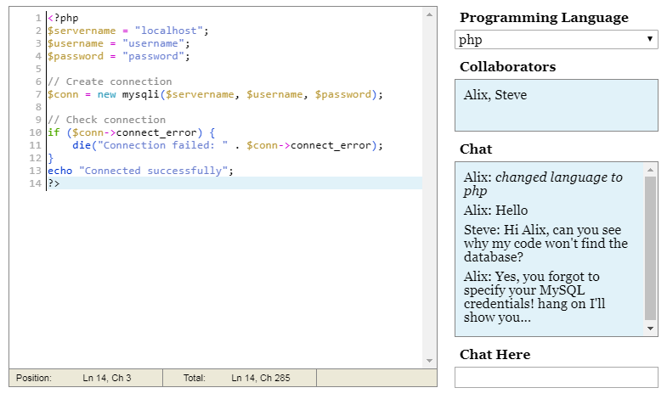
Collaborative editors
Collab edit
A simple collaborative editor
Does not run code
Syntax highlighting, Chat

Slide 13
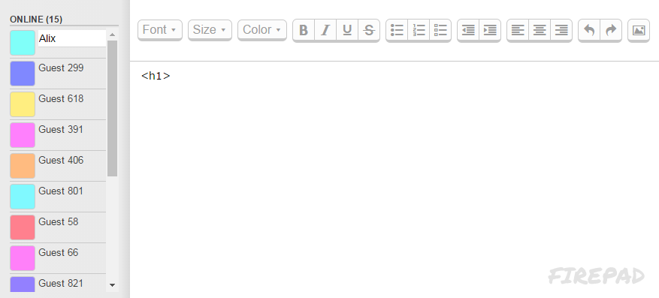
Collaborative editors
https://firepad.io/#1
Open source collaborative code/text editing
Browser-based, no reliance on server – all JavaScript.

Slide 14
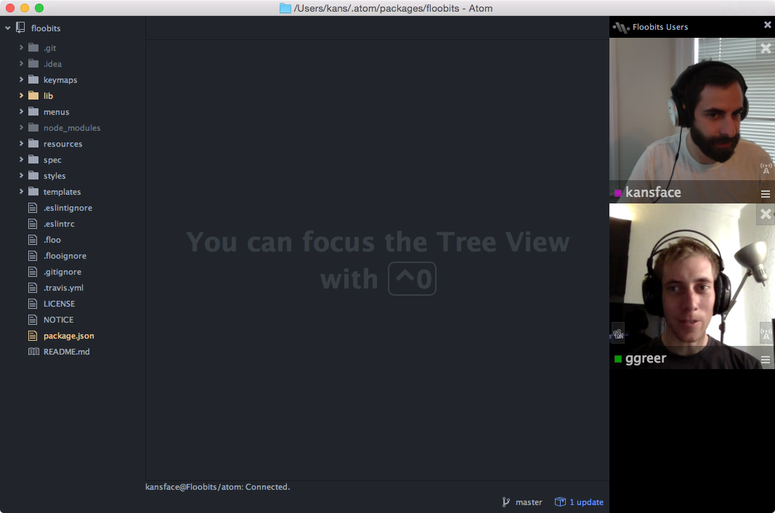
Collaborative editors
Floobits brings real-time collaborative editing to text editors, IDEs, and now Atom.

Slide 15
Collaborative editors
20 Best Code Editors for Real Time Collaboration

Slide 16
Wikis
MediaWiki
“MediaWiki is a free software open source wiki package written in PHP, originally for use on Wikipedia.”
Wikis can be a great way for teams to share ideas, code snippets, documentation etc.
Open source!
We use it on our student server.

Slide 17
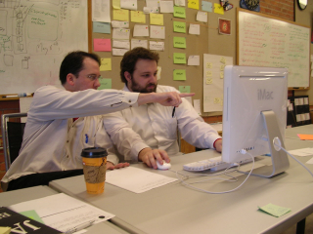
Pair programming
Pair programming is an agile software development technique in which two programmers work together at one workstation. (source)
One, the driver, writes code while the other, the observer or navigator, reviews each line of code as it is typed in.
The two programmers switch roles frequently.

Slide 18
Pair programming - pros
Economics – fewer defect in code
Design quality – different views and experiences
Satisfaction – work is more enjoyable
Learning – knowledge is shared
Team-building and communication

Slide 19
Pair programming - cons
Total number of man-hours increases
Complex from PM point of view
Reliance on individuals (skills, personalities, keenness etc.)
Will Pair Programming Really Improve Your Project?

Slide 20
Questions

